Slide 1
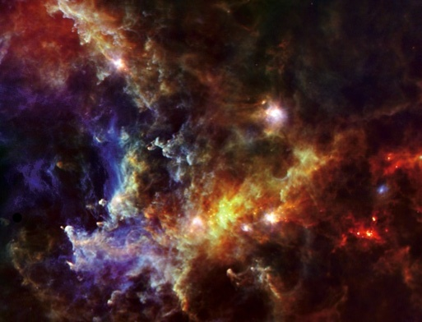
Observational and Theoretical Review of the Multiphase ISM
So, it works in Practice…but does it work in Theory?
So, it works in Theory….so What?
1)Galactic Diffuse Phases
2)Dark CO Gas
3)Decomposition of Phases
4)Miscellaneous Phases
Motte et al. 2010
Rosette

Slide 2
PDR: Gas phase in which FUV radiation
plays a role in the heating and/or chemistry
WNM
Warm H
T = 8000 K
n = 0.3 cm⁻³
FUV: 6 eV – 13.6 eV
G₀ = 1 Interstellar field
G₀: Habing χ:Draine ~1.7 G₀
U: Mathis ~ 1.1G₀
G₀ = 10⁵ Orion trapezium
r~ 100s pc
C⁺/HI
r ~ 10s pc
CNM
OB star
Cold H
T = 80 K
n = 30 cm⁻³
H⁺
FUV
H⁺
Cold H₂
T = 10 K
__
H⁺
A_{v} = 8
n_{e} = 30-100 cm⁻³
r ~ few pc
C⁺/H₂ “Dark” CO
Classic PDR

Slide 3
T = 10⁶ K HIM
WNM
Warm H
T = 8000 K
n = 0.3 cm⁻³
Warm H⁺
T = 8000 K
n_{e} = 5 cm⁻³
WIM
EUV
C⁺/HI
CNM
OB star
Cold H
T = 80 K
n = 30 cm⁻³
H⁺
FUV
H⁺
Cold H₂
T = 10 K
__
H⁺
A_{v} = 8
n_{e} = 30-100 cm⁻³
C⁺/H₂ “Dark” CO
Classic PDR
Short lived/Transient regions
(shocks, shears, turbulence)

Slide 4
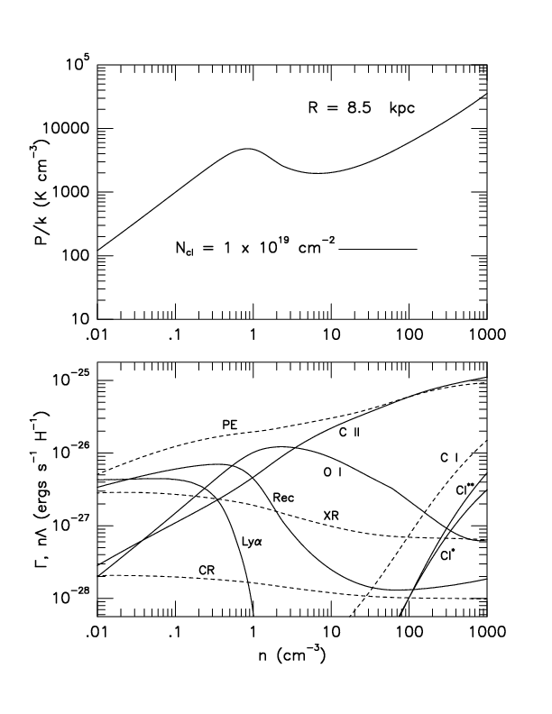
Diffuse Gas Heating/Cooling
Ionization: FUV, X-ray, C.R.
Heating: P.E., C.R., X-ray/EUV
Cooling: [CII], [OI], Lyα,
e⁻ recombination
= nT
WNM stable
CNM
stable
unstable
nΓ = n²Λ
T
T = 7860 n = 0.35 cm⁻³ WNM
T = 85 n = 33 cm⁻³ CNM
Wolfire et al. (2003)

Slide 5
Diffuse Gas Heating/Cooling
= nT
C II Cooling/H (CNM) >
10 CII Cooling/H (WNM)
Pmax
Pmin
** Note **
CNM in Thermal Balance:
[CII] measures the total
energy dumped into the gas.
Grain photoelectric
158 μm
63 μm
Heating Rate = const
n
Z
T
[CII] = const
Wolfire et al. (2003)

Slide 6
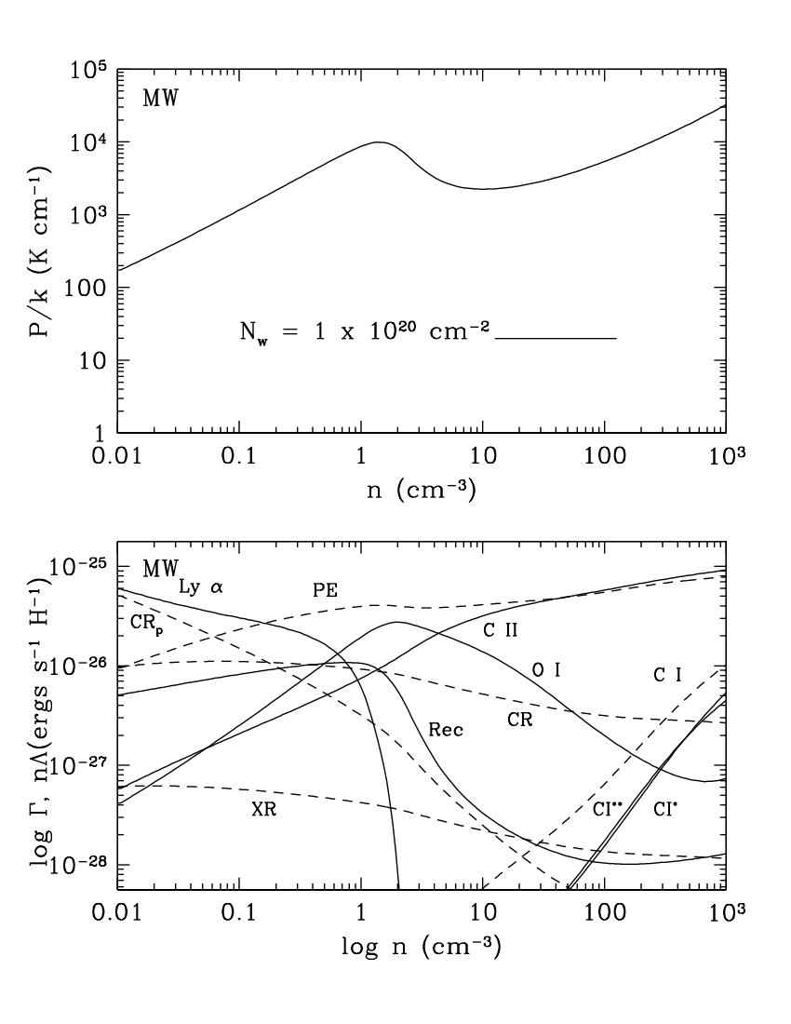
C.R. ionization
Indriolo et al. 2012
Diffuse Gas Heating/Cooling
Thermal Pressure
Jenkins et al. 2011
= nT
Pmax
Pmin
C II Cooling/H (CNM) >
10 CII Cooling/H (WNM)
** Note **
CNM in Thermal Balance:
[CII] measures the total
energy dumped into the gas.
Grain photoelectric
158 μm
63 μm
Heating Rate = const
n
Z
T
[CII] = const
Wolfire et al. (2013)
Notes:
But this is a TE, steady state picture. Is it at all relevant in light of the dynamic
and turbulent nature of the ISM?

Slide 7
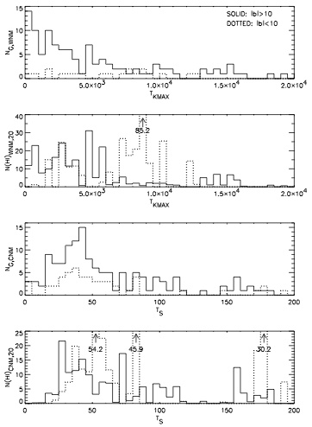
WNM temperature distribution
50% of gas mass in unstable Ts ???
Locally: 60% WNM, 40% CNM
(also Pineda et al. 2013)
In plane 25% of WNM in unstable Ts
or 15% of total mass.
Out of plane dominated
by dynamical processes.
In plane uncertainties large, and
statistics poor: 8 in 79 out
Heiles & Troland 2003, ApJ, 586, 1067
Begum et al. 2010
Notes:
Lets look to see if there is thermally unstable gas in the WNM. If there is a lot of unstable gas
Then this picture doesn’t really apply.

Slide 8
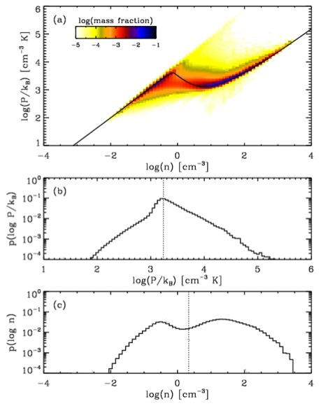
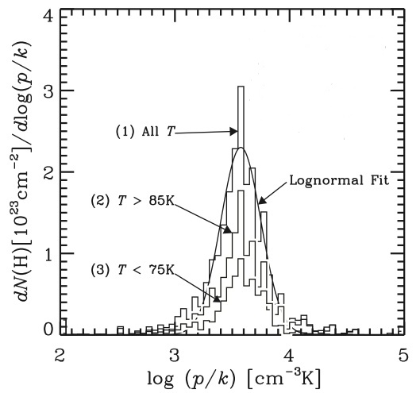
Multiphase Galactic Disks
Thermal Pressure in CNM
3800
P_{max}
P_{min}
Jenkins & Tripp 2011
Kim, Kim, & Ostriker 2011

Slide 9
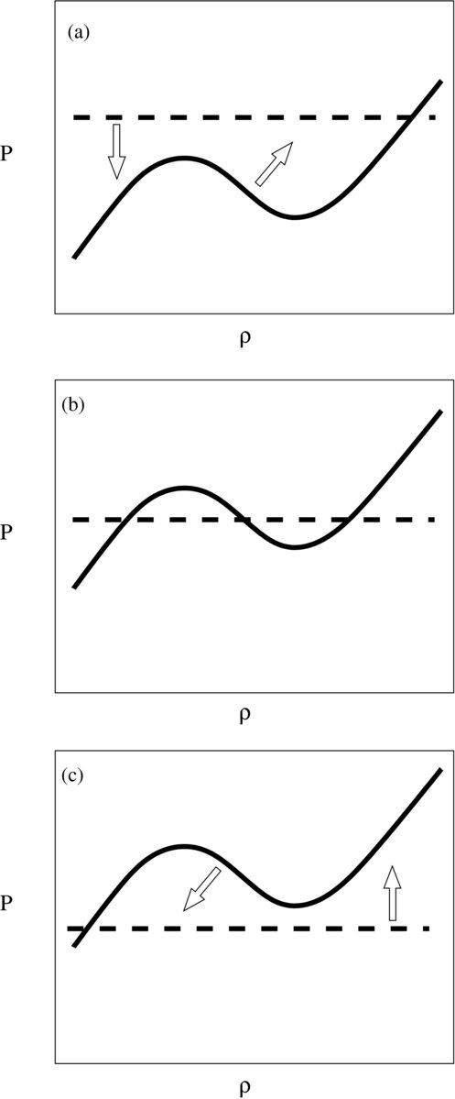
Regulation of Thermal Pressure
Midplane
Too Warm
Just Right
Pressure
Density
Too Cold
Ostriker, McKee, & Leroy 2010
Notes:
What is the mechanism that regulates the thermal pressure to keep it within the 2phase regime.

Slide 10
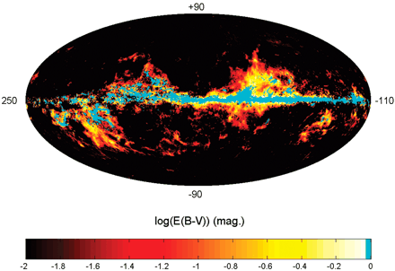
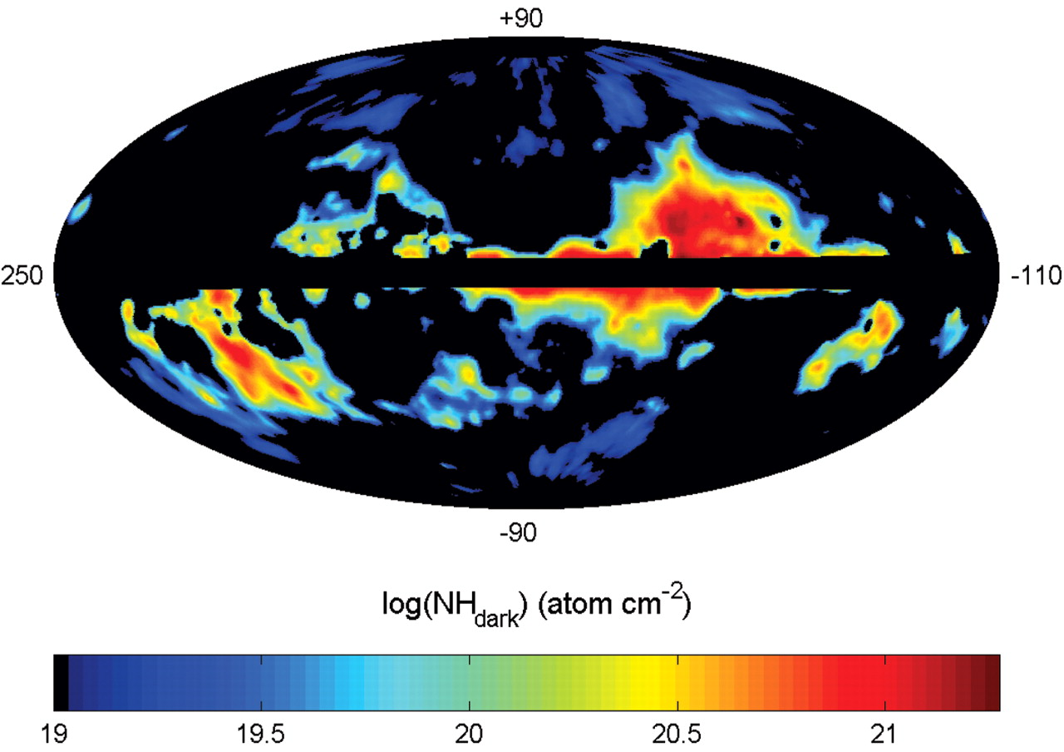
Molecular Hydrogen
Dark Molecular Gas
C⁺/H₂ but no CO
Ntot - N_{HI} - N_{CO} = N_{Dark Gas}
IRAS 100 μm 30% DG
Planck IR 50% DG
EGRET γ rays 30% DG
Fermi γ rays 50% DG
Extinction (2MASS) 43-71% DG
Herschel Got C⁺ 30% DG
Grenier et al. 2005, Science, 307, 1292

Slide 11
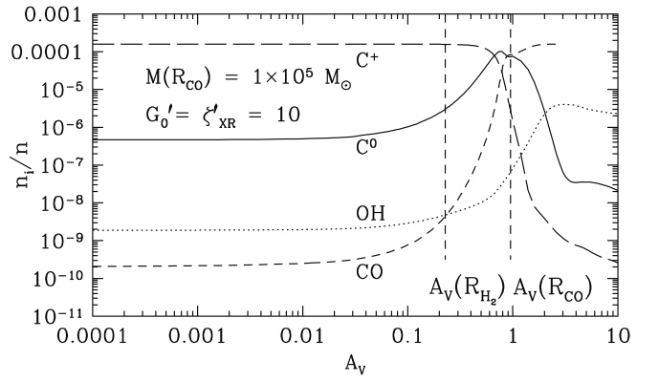
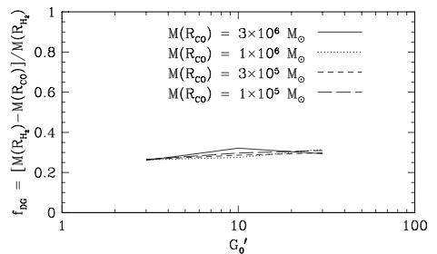
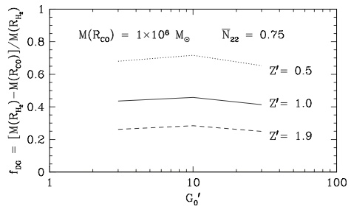
Tielens & Hollenbach 1985
van Dishoeck & Black 1988
Madden et al. 1997
(IC 10 80% PDR with C⁺/H₂)
ΔA_{V}
--
A_{V}
f_{DG}
Wolfire, Hollenbach, & McKee 2010
Dark
Gas
Fraction
Dark
Gas
Fraction
Grenier et al. 2005
Pineda et al. 2013

Slide 12
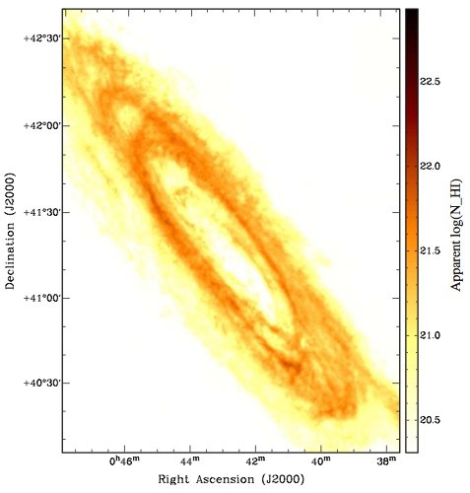
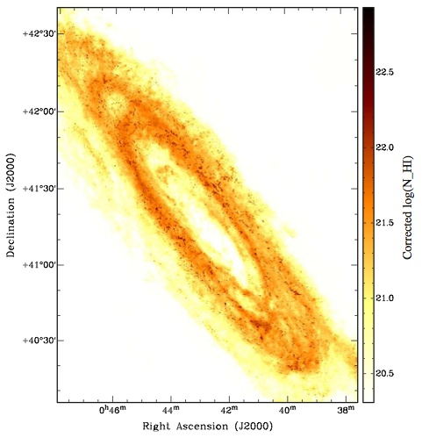
Braun et al. 2009
Dark Molecular Gas
?
M31
C⁺/H₂ but no CO
Ntot - N_{HI} - N_{CO} = N _{Dark Gas}
IRAS 100 μm 30% DG
Planck IR 50% DG
EGRET γ rays 30% DG
Assumed thin
Fermi γ rays 50% DG
Extinction (2MASS) 43-71% DG
Herschel Got C⁺ 30% DG
10 x HI column
M31
Hydro Models:
FUV penetration:
Glover & Mac Low 2011
Distribution of densities:
Glover & Mac Low 2007
Time dependence: Clark et al 2012
Corrected for
optical depth

Slide 13
Decomposition of Phases
WNM
[CII], N[II]
Warm H
T = 8000 K
n = 0.3 cm⁻³
Warm H⁺
T = 8000 K
n_{e} = 5 cm⁻³
WIM
r~ 100s pc
[CII], [OI]
r ~ 100s pc ?
[CII], [NII],
S[III], O[III]
[CII]
C⁺/HI
r ~ 10s pc
CNM
OB star
Cold H
T = 80 K
n = 30 cm⁻³
H⁺
H⁺
Cold H₂
T = 10 K
__
H⁺
A_{v} = 8
r ~ few pc
C⁺/H₂ “Dark” CO
CO
[CII],[OI], [CI], H₂

Slide 14
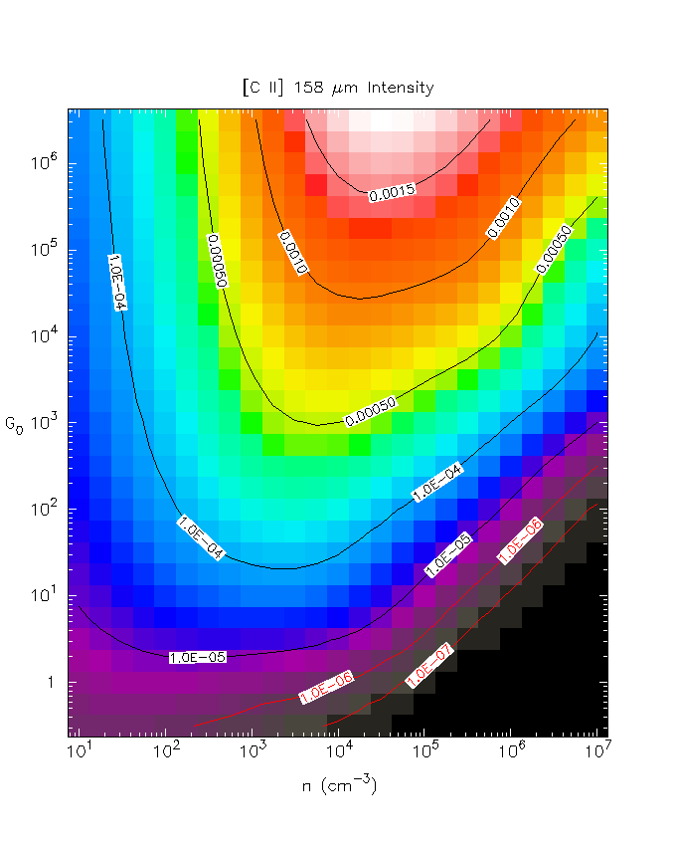
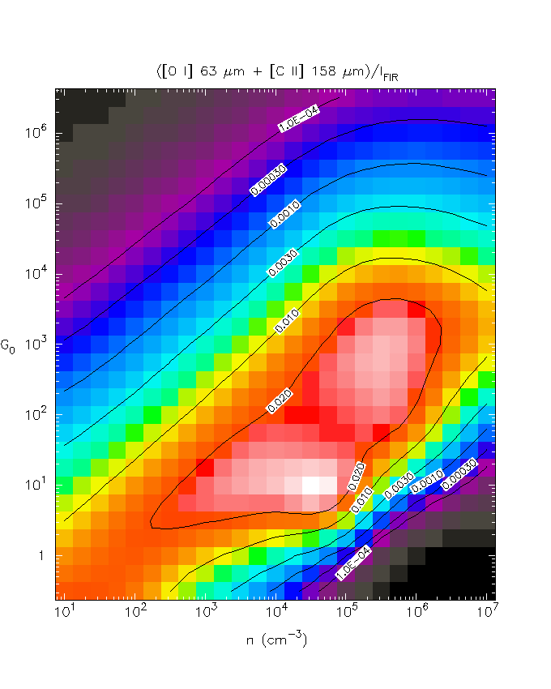
PDR Emission
[CII]
Heating Efficiency
Orion PDR
FUV
FUV
Classic PDRs
G₀/n = const
n
n
Kaufman et al. 1999
Kaufman et al. 1999
Diffuse Gas

Slide 15
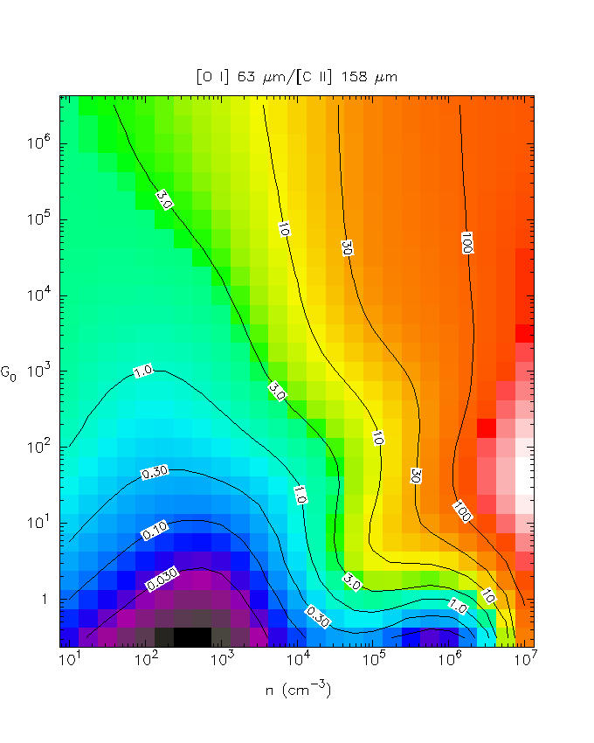
PDR Emission
[OI]/[CII]
Heating Efficiency
Orion PDR
n^{[CII]}
_{cr}
FUV
FUV
Classic PDRs
G₀/n = const
n
n
Kaufman et al. 1999
Kaufman et al. 1999
Diffuse Gas

Slide 16
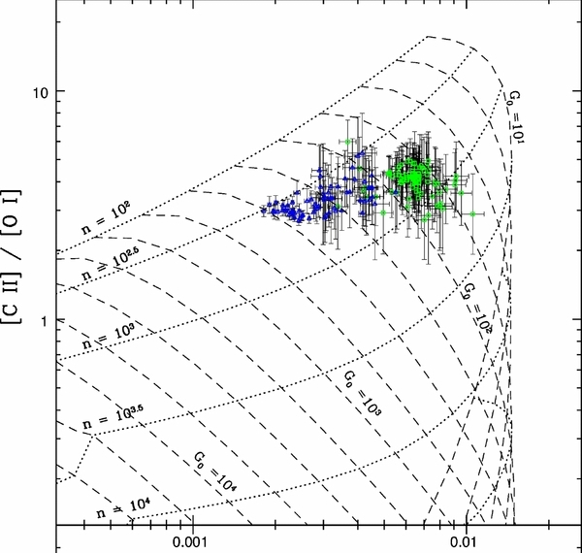
NGC 1097
NGC 4559
10
10²
10³
10²
n
G₀
10³
10⁴
Croxall et al. 2012

Slide 17
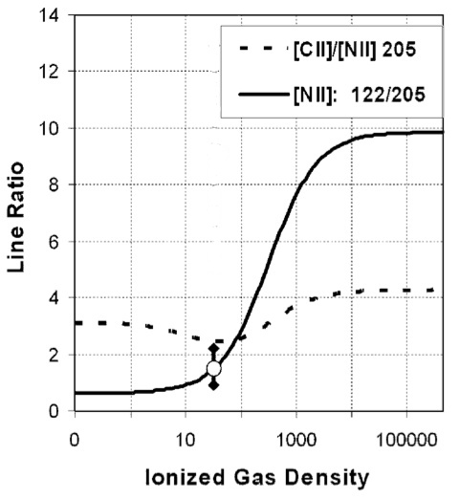
NGC 1097
NGC 4559
10
[CII]/[NII] 122
10²
10³
10²
n
G₀
10³
10⁴
Croxall et al. 2012
Oberst et al. 2006
What n_{e} to use?
Get n_{e} from [SIII] 18.7/33.5 for n_{e} > 10²
or
Pick n_{e} = 10

Slide 18
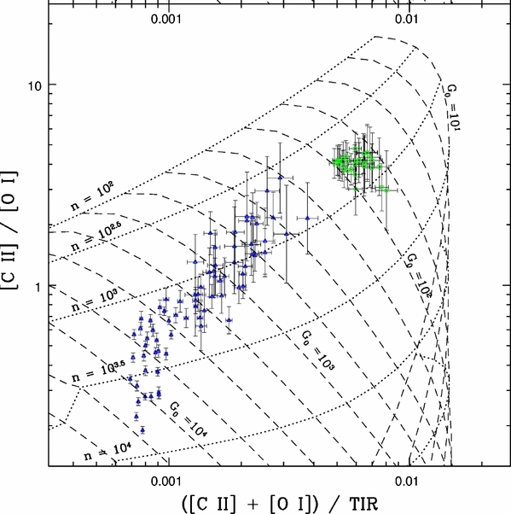
NGC 1097
[NII] 122
+ [SIII] 18.7/33.5
NGC 4559
10
10²
Ionized Gas
10³
10²
n
G₀
or
[NII] 122
+ n_{e} = 10
10³
10⁴
Croxall et al. 2012
Diffuse neutral emission
Constraints from dust emission

Slide 19
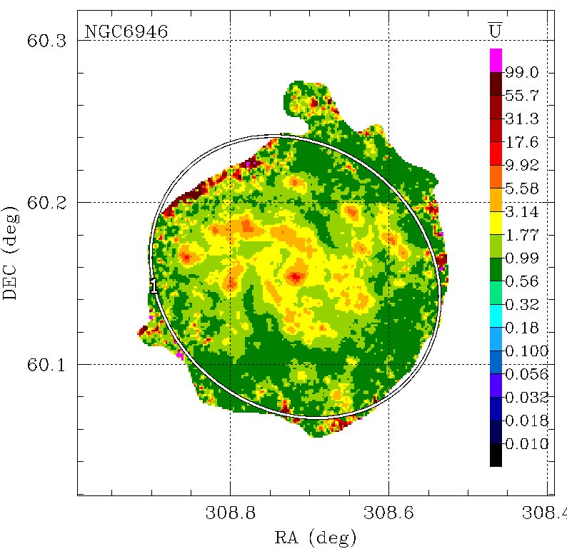
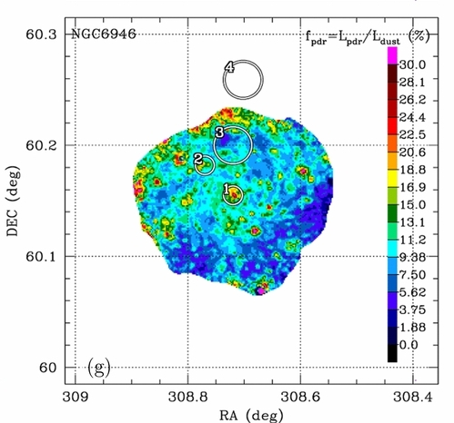
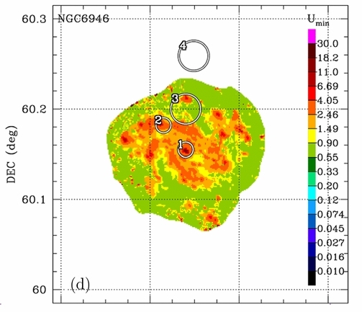
Averge U from dust emission
Draine & Li 2007
NGC 6946 PACS 160 resolution
~ 165 pc
Aniano et al. 2012

Slide 20
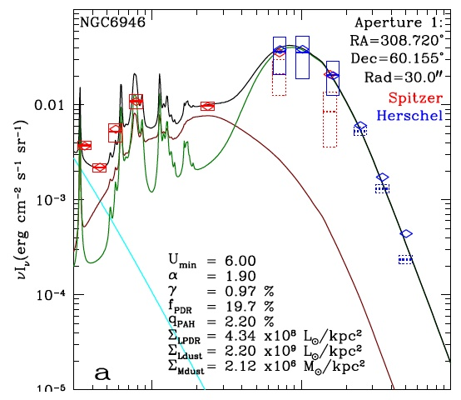
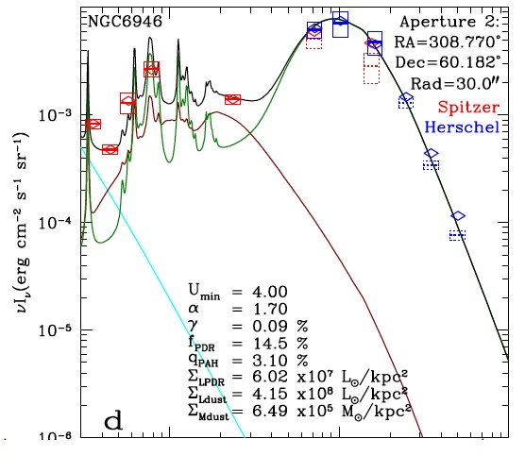
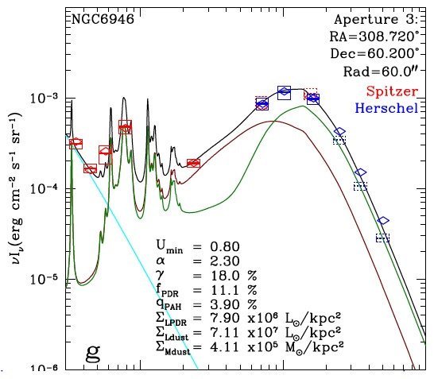
Low average U ~ 5, low f_{PDR} < 20%
Diffuse gas + low U on GMCs
Also Cubick et al. 2008, Pineda et al. (2010 , 2013) find U < 100
Wolfire, Hollenbach in prep: average U on GMCs ~10-30
Aniano et al. 2012

Slide 21
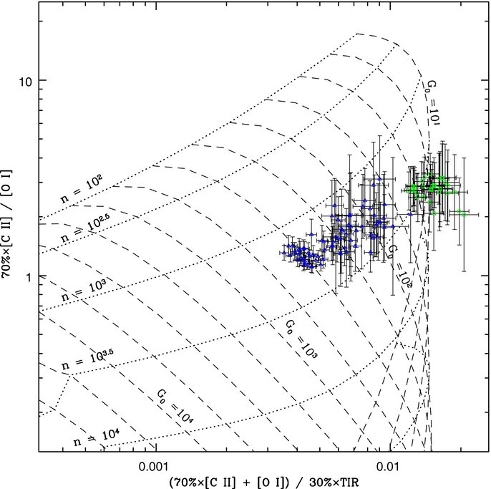
NGC 1097
[NII] 122
+ [SIII] 18.7/33.5
NGC 4559
10
10²
Ionized Gas
10³
10²
n
G₀
or
[NII] 122
+ n_{e} = 10
10³
10⁴
Croxall et al. 2012
Diffuse Gas
30% of [CII]
[NII] 122
+ n_{e} = 100

Slide 22
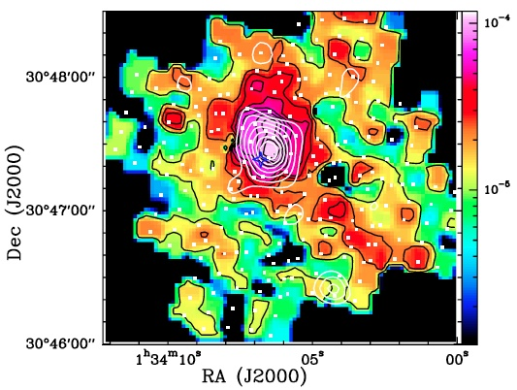
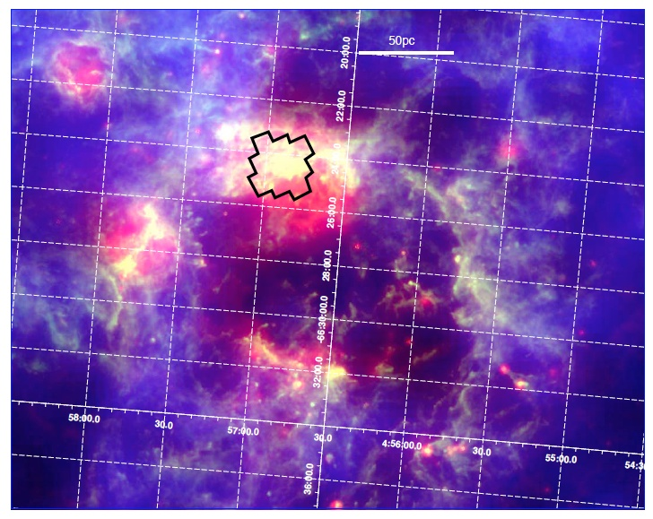
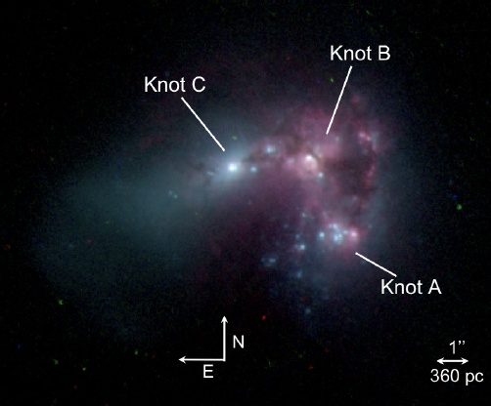
PACS [CII]
[OI]
M33 HII Region
PACS [CII] [OI]
LMC-N 11B
Mookerjea et al. 2011 HerM33es
Lebouteiller et al. 2012 SHINING
20-30% [CII] ionised gas
80-70% [CII] neutral PDR
5-15% [CII] diffuse ionised
85-95% [CII] neutral PDR
Haro 11
Cormier et al. 2012
90% [CII] diffuse
10% [CII] neutral PDR

Slide 23
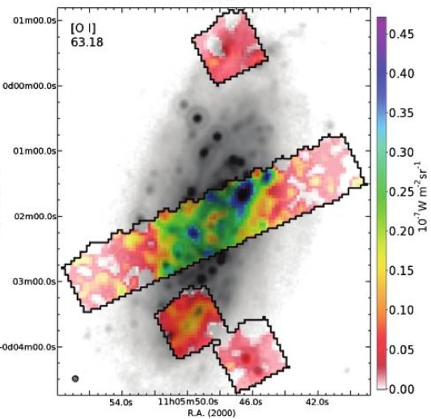
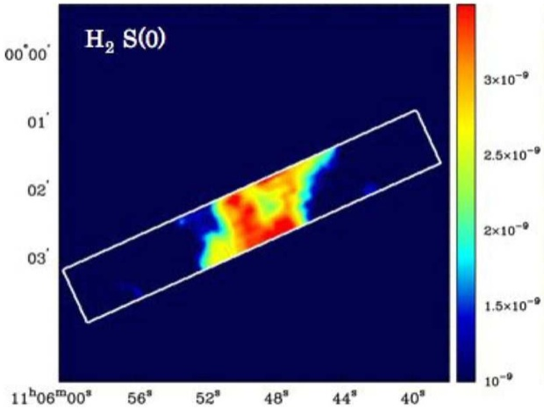
KINGFISH
NGC 3521
SINGS
Herschel PACS
Spitzer IRS
ΔE/k ~ 229 K
ΔE/k ~ 510 K
FWHM 250 pc
Kennicutt et al. 2011
Brunner et al. 2009
X-rays ? Meijerink et al. 2007
Cosmic Rays ? Meijerink et al. 2011
Shocks ? Appleton et al. 2006
Turbulent Dissipation ? Godard et al. 2009
Large scale mechanical energy dissipation ?
Roussel et al. 2007
Notes:
[CII] versus 24 um.

Slide 24
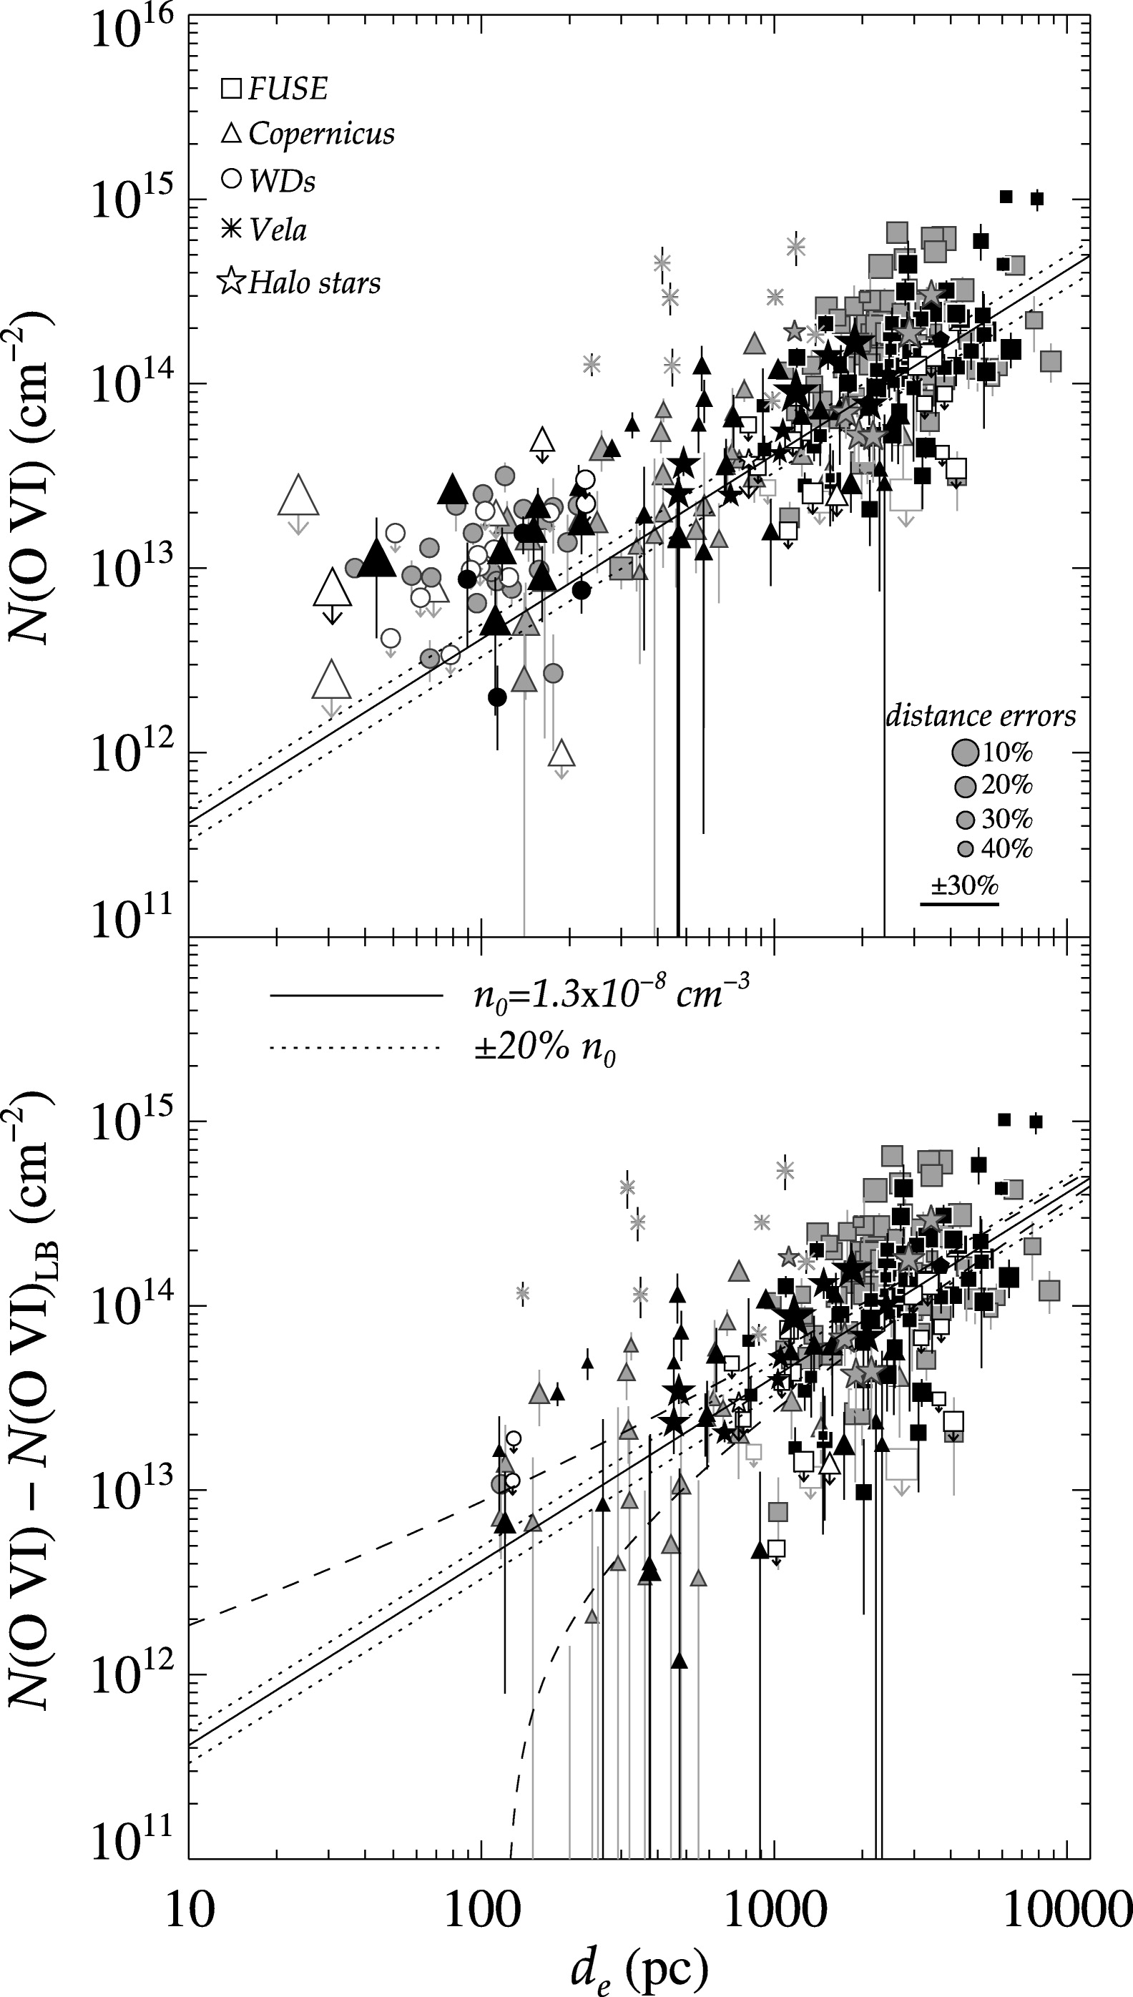
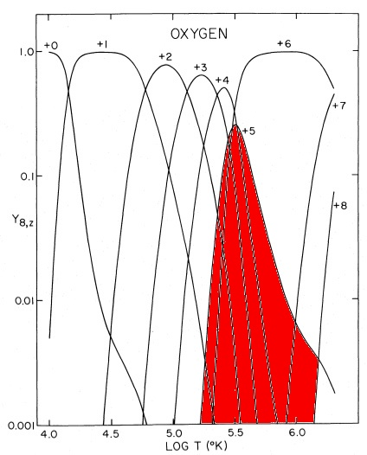
Phase Distribution Constraints from OVI
n₀ = 1.3x10⁻⁸ cm⁻³
N(OVI) from FUV absorption line of OVI
WNM
X-RAY
Conductive interfaces
Turbulent mixing layers
de Avillez & Breitschwerdt 2005
Bowen et al. 2008

Slide 25
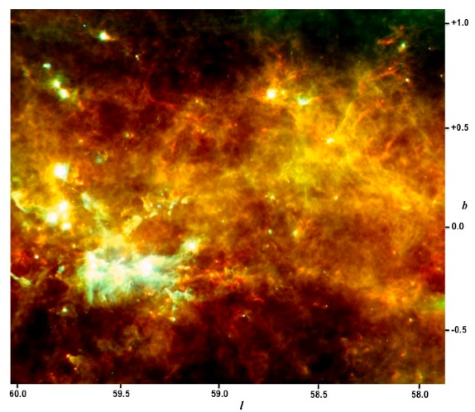
Phase Distribution Constraints from OVI
n₀ = 1.3x10⁻⁸ cm⁻³
N(OVI) from FUV absorption line of OVI
n(OVI) only few 10⁻⁸ cm⁻³
D. Cox numerous
MO too much OVI
Slavin & Cox clouds in WNM reduces OVI
Reality!
Bowen et al. 2008

Slide 26
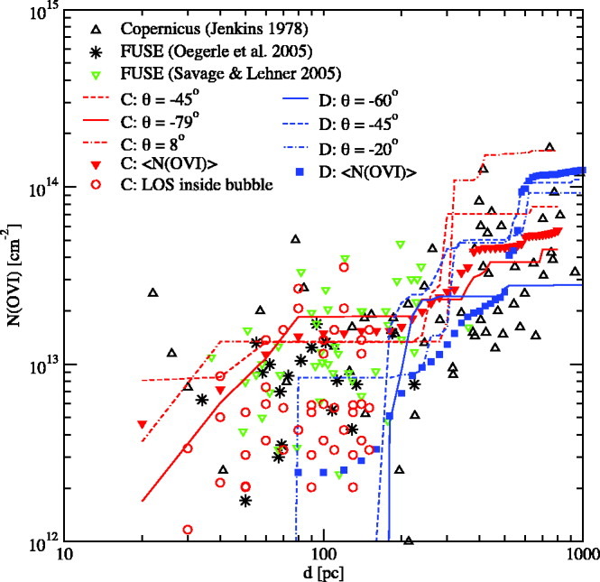
Phase Distribution Constraints from OVI
n₀ = 1.3x10⁻⁸ cm⁻³
N(OVI) from FUV absorption line of OVI
de Avillez & Breitschwerdt 2005
Bowen et al. 2008
Notes:
The key is getting the proper mix of HIM, and cooler WNM, and getting the hot gas to mix in turbulent interfaces

Slide 27
Conclusions
1.)CNM pressure distribution width set by turbulence but median
set by two-phase pressure.
2.)Tenatively: the mass fraction of in-plane thermally unstable gas is
not very high. I am waiting for better statistics.
3.)The mass fraction of out-of-plane thermally unstable gas IS high
4.)Self-regulating cycle (pressure, star formation, phase transitions)
maintains the two-phase pressure in the midplane
5.)Dark gas. How do models compare with observations (at low Z).
Could it be substaintially HI and not H₂? Do hydro models produce
more DG?
6.) Ample evidence for small scale mechanical heating/turbulent
dissipation. Can this dominate at large scale in diffuse gas?

Slide 28
Conclusions
7.) [CII] mainly comes from moderate n and moderate to low G₀
PDRs plus some neutral diffuse gas (mainly in outer galaxy).
8.)WIM/HII contribution to [CII] is uncertain ~ 30%
9.)OVI constraints. Must not overproduce OVI. Likely
comes from turbulent mixing regions between HIM/CNM/WNM

